Slide 1
Supersales Pitch Deck

Slide 2
Executive Summary
Supersales as started as a furniture sales company since 2022. This document is serve as both an analysis of the overall sales for the past 3 years within the US and Canada market with recommendations
As of 2026, it can be seen that our sales within Canada is unstable unlike our US market which is growing constantly since 2022. Our Product in the technology segment remains as our most profitable product segment despite the lower amount of quantity sold. Not only that, despite our website being online and in used by customer, we are lacking critical information in understanding both the user journey from our online advertisement and usage of the website
Our web development team is required to work with our marketing team in linking up the online advertisement data with our sales data and to also include user journey data within our website in better understanding the user journey before pre-purchase. Not only that, it’s also recommended for the sales team to conduct surveys within the Canada market to better understand the requirements of the Canadian customers and make possible changes.

Slide 3
Business problem and key questions
Problem:
Sales in the US markets are growing since the start of 2022 but the sales in Canada Market is unstable.
The rate of sustainable profit by sales is questionable due to a lack of consistent frequency of purchases
Key Question:
What is contributing the growth within the US market?
Why there is a lack of growth within the Canada Market
What are the possible method to create a sustainable profit period without relying too heavily on seasonal purchases?

Slide 4
Dataset Used
Superstore Dataset file
Link to Dataset in github: https://github.com/laigunner03/modefair/blob/main/sample_-_superstore.xls
Dashboard link:
Github file: https://github.com/laigunner03/modefair/blob/main/MF%20Supersales%20Analysis.twbx
Tableau Public: https://public.tableau.com/views/MFSupersalesAnalysis/SuperSalesAnalysisStory?:language=en-US&publish=yes&:sid=&:redirect=auth&:display_count=n&:origin=viz_share_link

Slide 5
Data model or table structure
Row ID (INT64)
Order ID (String)
Order Date (Date)
Ship Date (Date)
Ship Mode (String)
Customer ID (String)
Customer Name (String)
Segment (String) (String)
Country/Region (String)
City (String)
State/Province (String)
Postal Code (String)
Region (String)
Product ID (String)
Category (String)
Sub-Category (String)
Product Name (String)
Sales (Float)
Quantity (INT64)
Discount (Float)
Profit (Float)

Slide 6
Key metric definitions
Sales: Total price the product is sold for
Profit: Total Profit ear
Quantity: Amount of Product Sold
Discount Used: Total amount of Discount used by customer
Customer ID: Unique ID of the customer
Latest Order Date: Latest date the customer made order with the company
Segment: Product Category
Sub-Category: Type of product within Category

Slide 7
Cohort, retention, or repeat behaviour analysis
As shown within the Sales by Top 10 states for past 3 years, most of the company sales are made within top most populated states within the US.
This points to a consistent possible method of creating a sustainable profit for the company but with the key point of the heavy competition within those states with our competitors

Slide 8
Segmentation analysis
Within Sales Details in top 10 States, the most sales we made within the Product Category are in the Technology Category yet the quantity sold is lower than the Office Supplies Category .
This points to the high profitability of the Technology Category but with the lower amount of quantity sold points to the lack of suitability as a sustainable source of profit. Unlike office supplies that despite the lower profitability is constantly being purchased by our customer which points to a higher suitability as a sustainable source of profit.

Slide 9
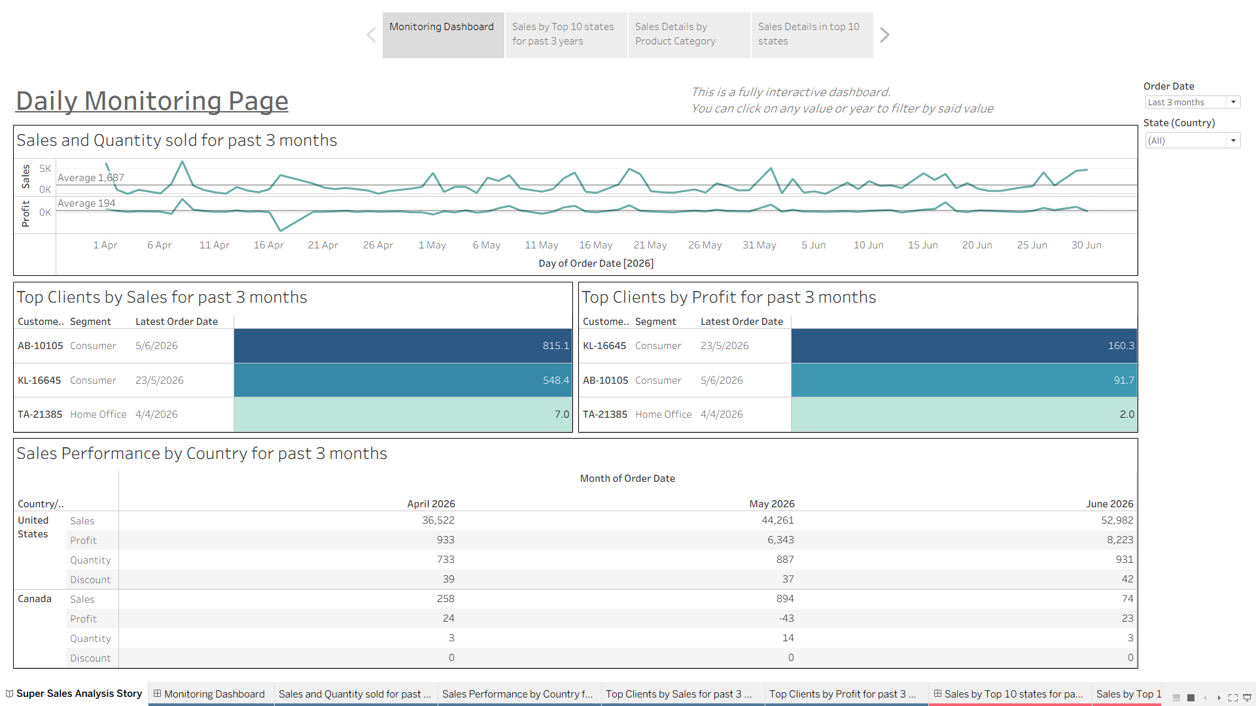
Dashboard design and daily monitoring approach
The daily monitoring page is the page that shows the key metrics that needed to be monitor including the general trend of Profit and Sales for past 3 months, Total Sales,Total Profit, Total Quantity of Product sold by country. And the key top clients to keep track by Sales and Profit respectively

Slide 10
Data quality issues and missing data points
Current dataset is missing any supporting data to support a proper funnel chart as the business model of the dataset used is a simple B2C business without any support data like marketing or advertising data

Slide 11
Recommended engineering instrumentation
Recommendation to include marketing or advertisement data into the dataset especially the number of clicks, duration of view in order to help with the Pre-order phase of the user journey
This would help with the marketing strategy or method to attract more clients

Slide 12
Final recommendations and next steps
Office supplies is pointed to be as a feasible product to possibly push sales in as the product such as chairs tend to be the number one furniture being purchase for any offices next to desk.
It is recommended to push more marketing towards this category of product with possibly of a bulk purchase discount in order to attract more customer or repeat business
In order to increase our presence within the Canada Market
The recommendation is to research our competitors within the Canadian market and conduct market survey while involving our Canadian staff to include some ground level view that any research or survey may have missed

Slide 13
Reason of why I am the right person
I’ve work in an environment where clear and precise communication is required with multiple stakeholders in order to create a correct requirements for their request and creation of dashboards/report
My approach towards analytics is to find the truth and gather supporting data for the conclusion even if my initial hypothesis is incorrect
I’ve have experience on data modeling based on stakeholders’ requirement

